Slide 2
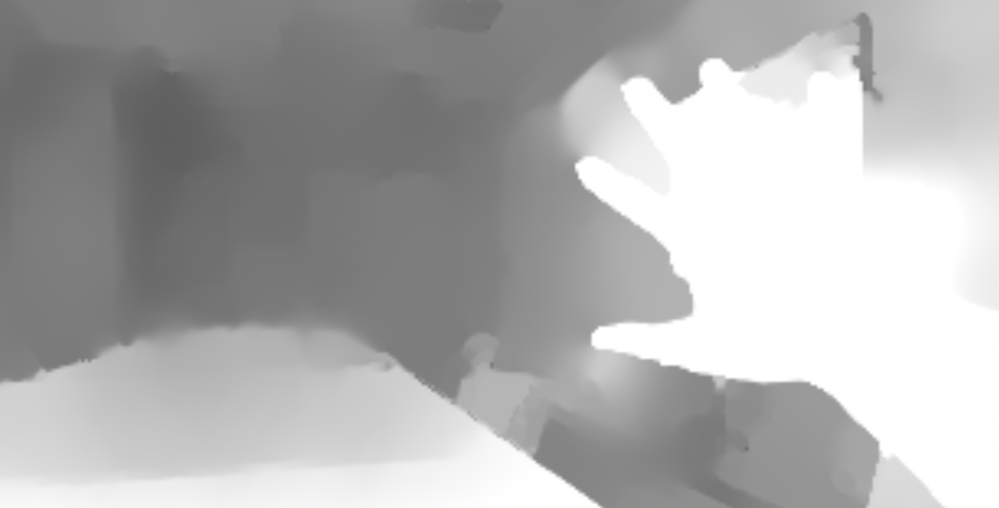
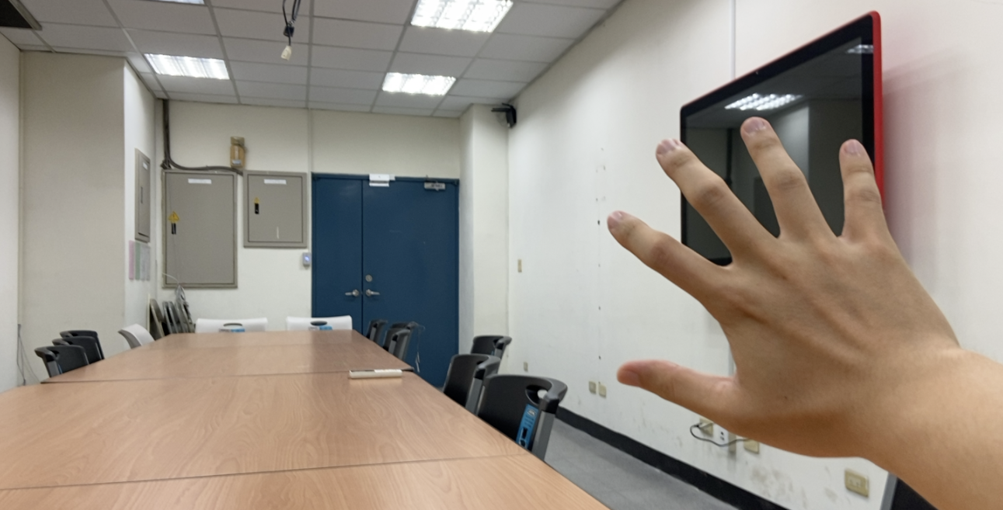
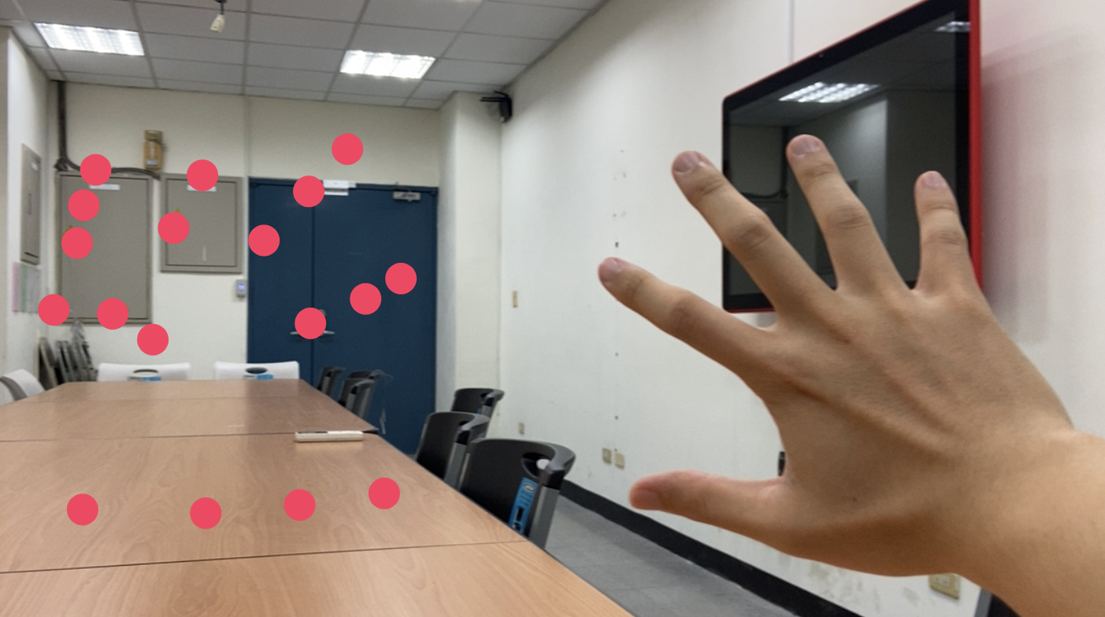
Software Ver 1: Reconstruct 3D
Dual Camera
Vision Library
AVCapturePhotoOutput
ML hand joints detector
Wide-angle image
(secondary camera)
Telephoto image
(main camera)
Disparity
2D
Hand joints result
Depth Map
AVCaptureSession
Main Tread
3D
Hand joints result
Renderer
Mirroring
Preview
UIViewController

Slide 3
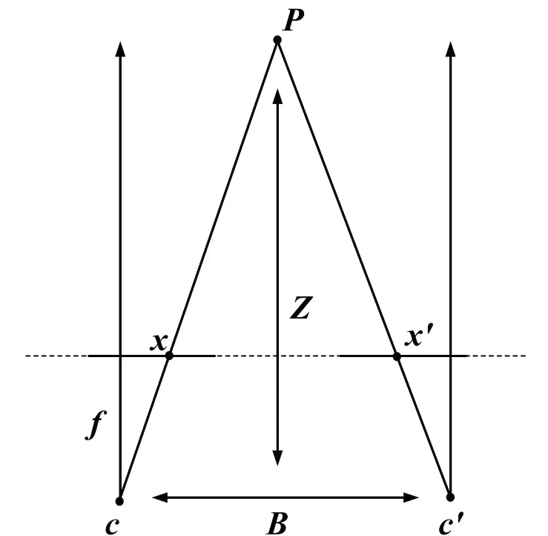
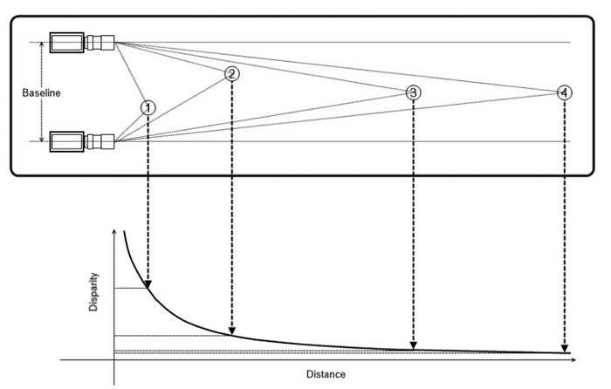
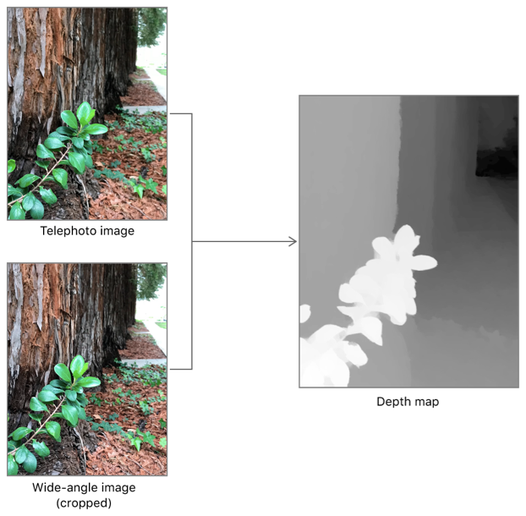
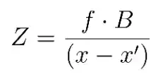
Dual camera estimate depth
EXP on iPhone 11
Output Value
9999.9f
0.2f
0.8f
“This level of accuracy indicates that values within a depth map are usable relative to one another (that is, a depth value of 2 is twice as far as a depth value of 1), but do not accurately convey real-world distance.”
Dramatically increase
Unstable increase
Linear decrees
Real Depth
0 cm
10 cm
20 cm
80 cm
Notes:
Ref:
https://www.digitalnuage.com/disparity-and-depth-estimation-from-stereo-camera
https://www.oreilly.com/library/view/learning-opencv-3/9781491937983/
https://developer.apple.com/documentation/avfoundation/avdepthdata/accuracy/relative
https://developer.apple.com/documentation/avfoundation/additional_data_capture/capturing_photos_with_depth

